Slide 1
Customer Lifetime Value
(in R)
Felix Schildorfer
Notes:
Ask audience if they now the definition

Slide 2
Introduction to CLV
Definition: the present value of the future cash flow (profit) associated with a specific customer relationship
The Good
The Bad
The Ugly
Nike
Nike’s stock has gone on a meteoric rise in the last few years, due large parts to their acquisition of, Fader and McCarthy's former company, Zodiac, which specialized on CLV Analytics.
Overstock
While initially having solid customer base Overstock decided to challenge Wayfair and blindly expand without any consideration of unit economics. After an initial surge their stock fell greatly once the reality of their decision became apparent.
Blue Apron
Blue Apron has been in a free fall since its IPO mainly due to their challenging unit economics. The most crucial on being that they lose money on around ~70% of customers they acquire.

Slide 3
Classifying Customer Bases
Groceries
Clothes
Hotel Stays
Credit Cards
Mortgages
Lifetime programs
Continuous
Conferences
Prescriptions
Charity fundraisers
Magazine Subs
Insurance
Streaming Subs
Discrete
Non-contractual
Contractual
Notes:
The most important thing to consider when calculating CLV

Slide 4
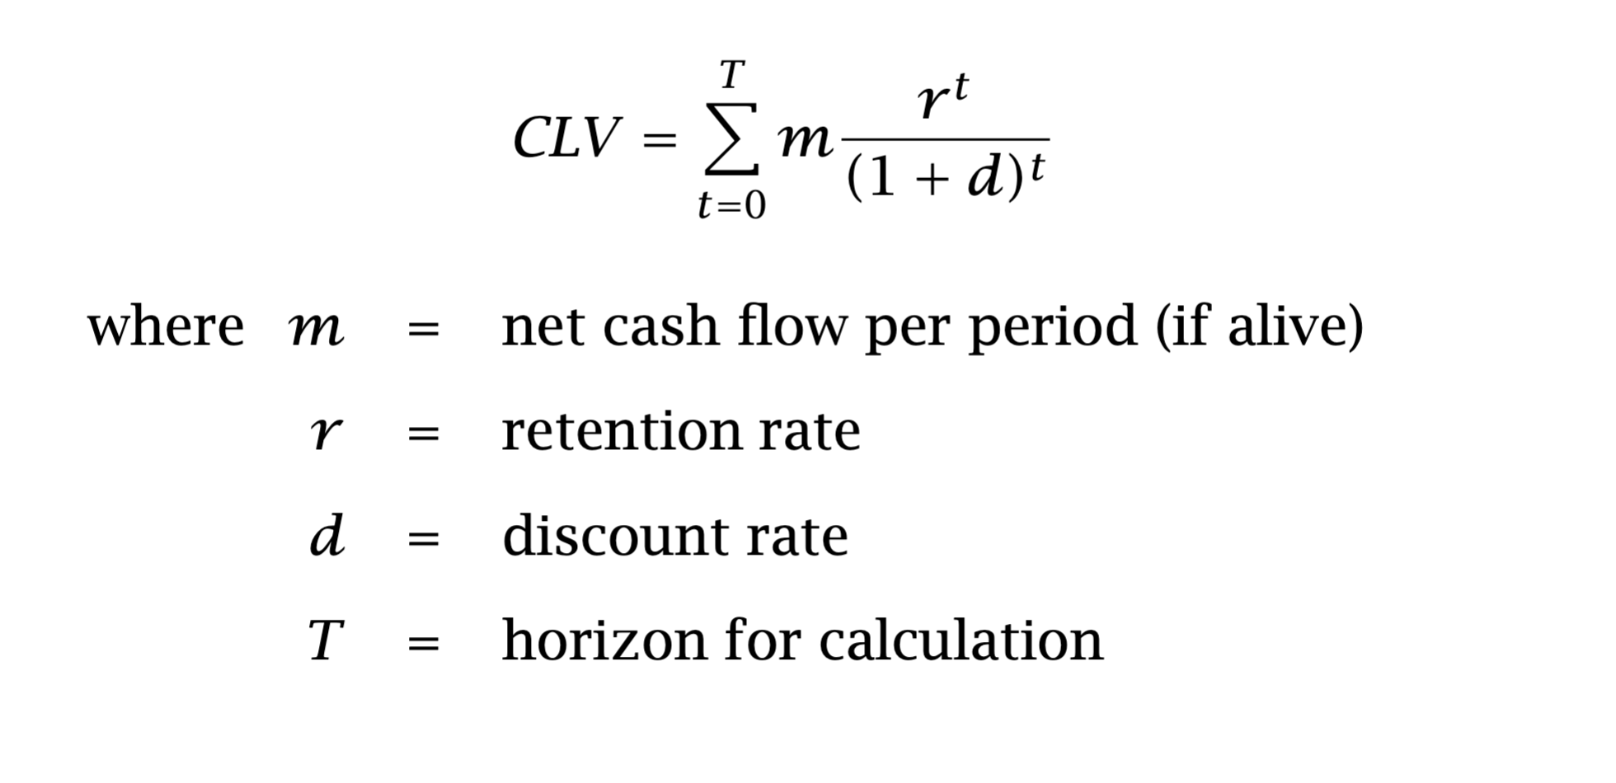
Classic Formula
Notes:
What is wrong with this formula? Everything
On the left side
“CLV” makes it seem like it is deterministic
There is some random error
Should be E(CLV)
On the right side
Summation implies discrete
You can take a continuous process and make it discrete (discretize)
You CANNOT take a discrete process and make it continuous
Time should go on forever
Need to allow for the possible that the customer can live forever
Even though this is very unlikely
If you’re doing a portion of the future value of the customer (e.g., C3V),
that’s fine – but be open about the discrete horizon
t=0 implies no history
Doing calculation from the moment before we acquire you as a customer
Realistically, there is probably historical value
How can you calculate lifetime value about a customer we know nothing
About?
Why would we calculate CLV for an as-yet-to-be-acquired customers?
Customer acquisition costs
Instead of obsessing over reducing costs per acquisition (CPA),
focus on the right customers (“look up, think about the CLV and
let that drive your decisions”)
M suggests cash flow per period is constant over time
This is why we need a spend model
Retention rate
Implies contractual setting
Makes no sense to talk about retention rate in noncontractual setting
Implies certain relationship between t and S(t)
Implies the curve of S(t) vs. t is ever-decreasing – survival curve NEVER
looks like this
The real shape is a steep drop at outset and levels off much faster and
more dramatically
These two differences are perfectly reflective of heterogeneity (shakeout)
We lose the high-theta people
Left with low-theta people who will stay with us for a long time
Time value of money
Discount rate should be thoughtful – maybe we should even use different
discount rate for different segments of customers or geographies
Discount rate really matters!

Slide 5
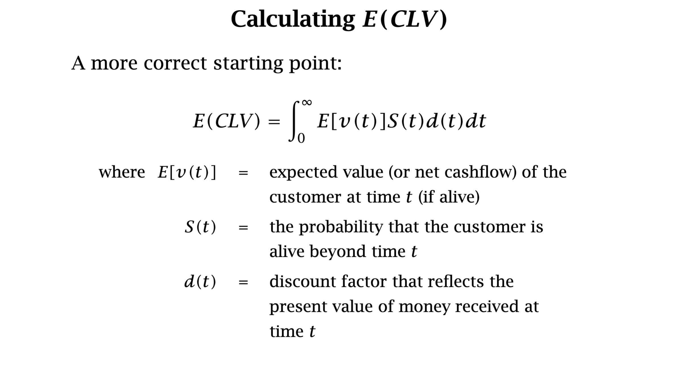
The truth can be scary
Notes:
This is more correct, this is what we need to operationalize!

Slide 6
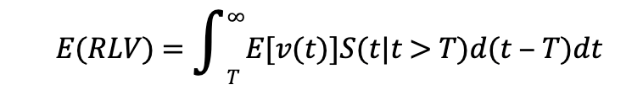
And for existing customers
Notes:
At this point you might be thinking, what did I walk into? Why am I being given a math lecture.
So now we need to operationalize this. This is where it gets really interesting. Let’s go right after the MOST DIFFICULT case.
Let’s remind ourselves what are the most difficult aspects about it: 1) unregular purchasing pattern 2) can’t observe retention

Slide 7
Buy Till You Die
The Buy Till You Die (BTYD) class of statistical models are designed to capture the behavioral characteristics of non-contractual customers, or when the company is not able to directly observe when a customer stops being a customer of a brand. The goal is typically to model and forecast customer lifetime value.
BTYD models all jointly model two processes:
(1) a repeat purchase process, that explains how frequently customers make purchases while they are still "alive"; and
(2) a dropout process, which models how likely a customer is to churn in any given time period.
Common versions of the BTYD model include:
The Pareto/NBD model
The Beta-Geometric/NBD model
The Beta-Geometric/Beta-Binomial model
Notes:
Story of two coins/dice:
Truly forward looking
Compare strengths of traditional ML Models vs Probabilistic Model

Slide 8
BTYD in R
https://cran.r-project.org/web/packages/BTYD/index.html
Summary:
The BTYD package contains models to capture non-contractual purchasing behavior of customers—or, more simply, models that tell the story of people buying until they die (become inactive as customers). The main models presented in the package are the Pareto/NBD, BG/NBD and BG/BB models, which describe scenario of the firm not being able to observe the exact time at which a customer drops out. We will cover each in turn.
Notes:
Written and maintained by Daniel McCarthy and a bunch of other students of Fader

Slide 9
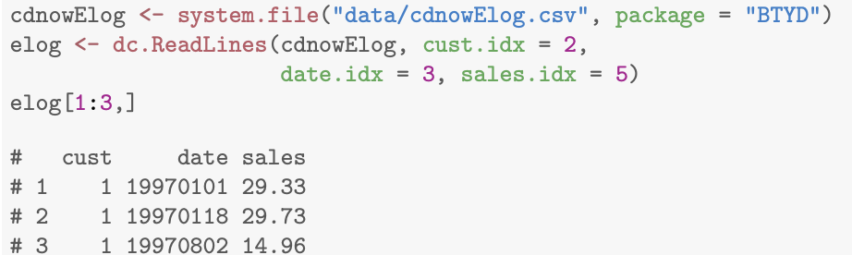
Data
Customer ID: unique identifier for each customer
Date: rough date of transaction (day/week/month)
Sales: purchase amount
 | cust | trans_date | sales
1 | 1 | 19970101 | 29.33
2 | 1 | 19970118 | 29.73
3 | 1 | 19970802 | 14.96
4 | 1 | 19971212 | 26.48
5 | 2 | 19970101 | 63.34
6 | 2 | 19970113 | 11.77
7 | 3 | 19970101 | 6.79
8 | 4 | 19970101 | 13.97
9 | 5 | 19970101 | 23.94
10 | 6 | 19970101 | 35.99
11 | 6 | 19970111 | 32.99
12 | 6 | 19970315 | 77.96
13 | 6 | 19970416 | 59.3
14 | 6 | 19970424 | 134.98
Notes:
Needs very basic data, talk about each data set and it’s difficulties.

Slide 10
Data Pipeline
1. Merge Transactions
2. Split Data

Slide 11
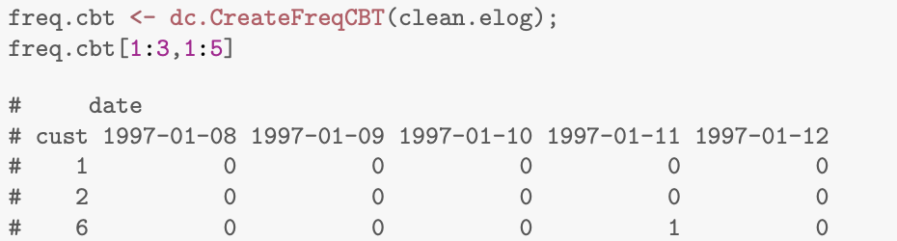
Data Pipeline cont.
3. Create Customer-by-time (CBT) Matrix
4. Merge back one-time customers

Slide 12
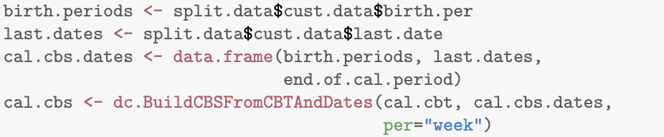
Data Pipeline cont.
5. Create Customer-by-sufficient-statistics (CBS) Matrix
6. Or the shorter version
dc.ElogToCbsCbt(elog, per = "week", T.cal = max(elog$date), T.tot = max(elog$date), merge.same.date = TRUE, cohort.birth.per = T.cal, dissipate.factor = 1, statistic = "freq")

Slide 13
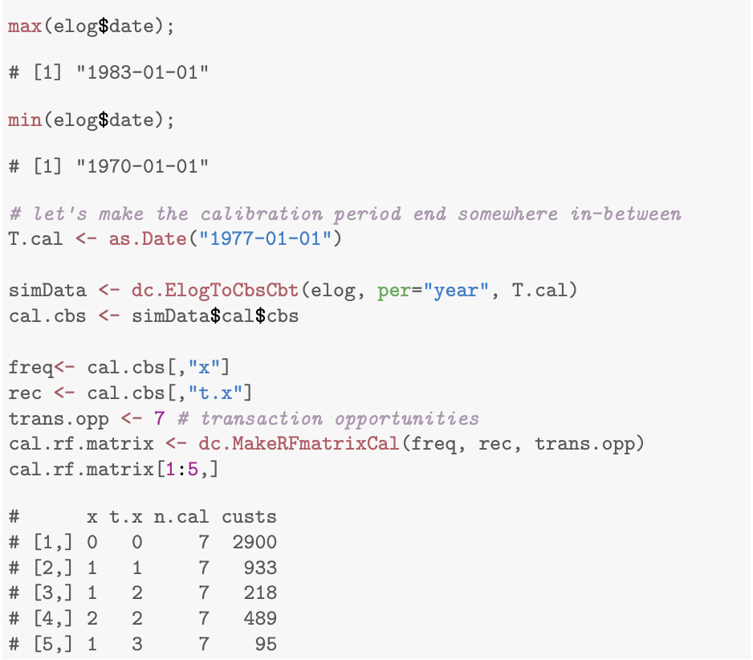
Data Pipeline cont.
7. For the BG/BB Method we need to go one step forward and create a RFM from the CBS

Slide 14
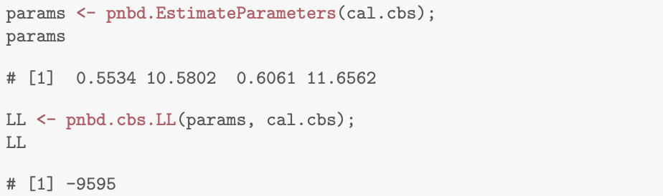
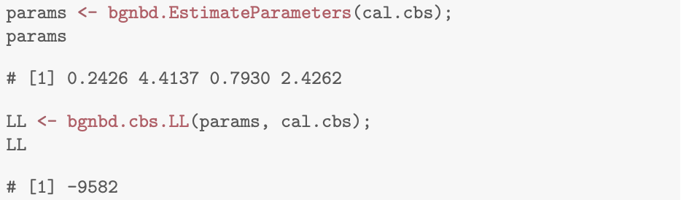
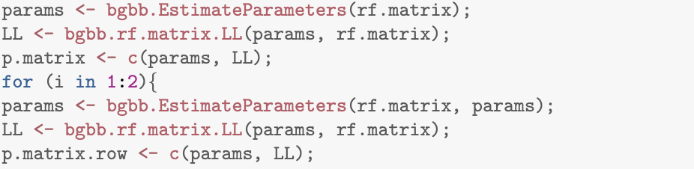
Purchase Frequency Distributions
Pareto/NBD
Beta-Geometric/NBD
Beta-Geometric/BB
*Making sure parameters converge

Slide 15
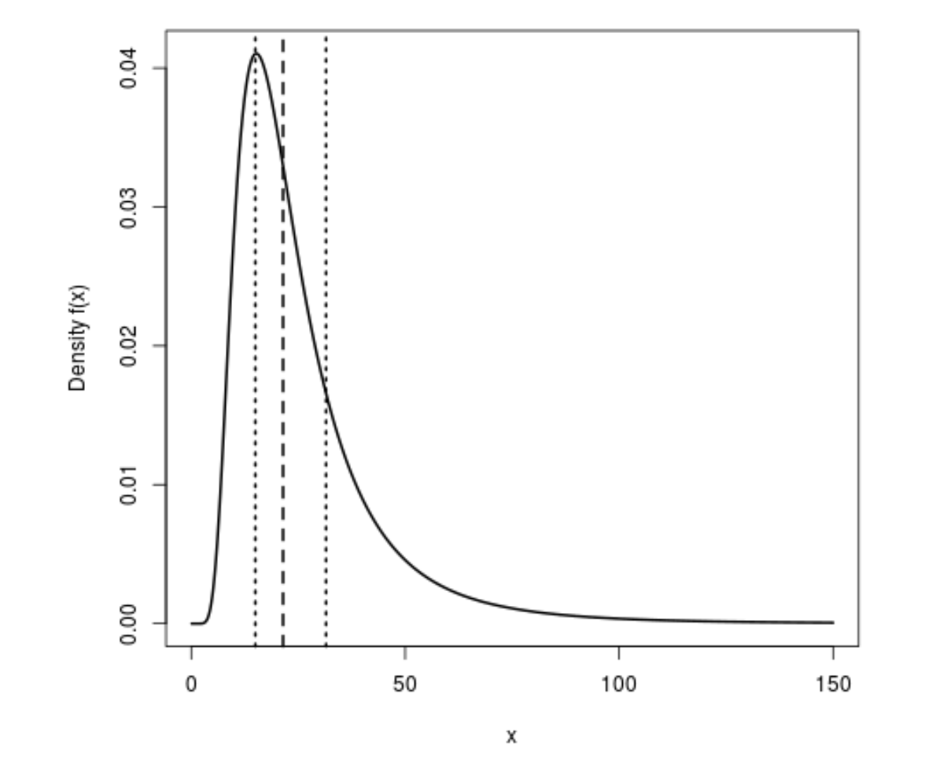
AOV Distribution
A Gamma-Gamma distribution with parameters shape1 = a, rate1 = r and shape2 = b has density
f(x) = [(r^a)/(Gamma(a))][Gamma(a+b)/Gamma(b)] [x^(b-1)/(r+x)^(a+b)]
for x > 0 where a,r > 0 and b = 1,2,….
The distribution is generated using the following scheme:
Generate Y ~ Gamma(shape=shape1,rate=rate1).
Generate X ~ Gamma(shape=shape2,rate=Y).
Then, X follows a Gamma-Gamma distribution.
Example Code:
spend.EstimateParameters(ave.spend, tot.trans)

Slide 16

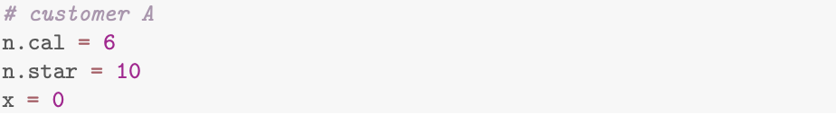
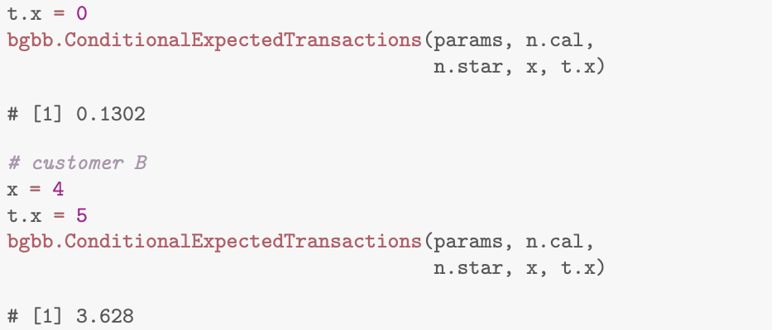
Individual Level Predictions
Average New Customer:
Existing Customers:

Slide 17
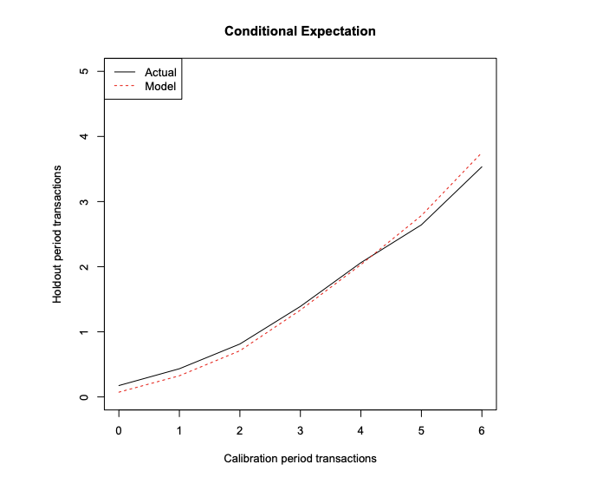
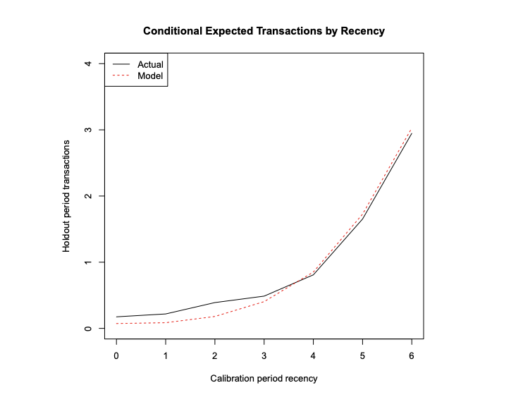
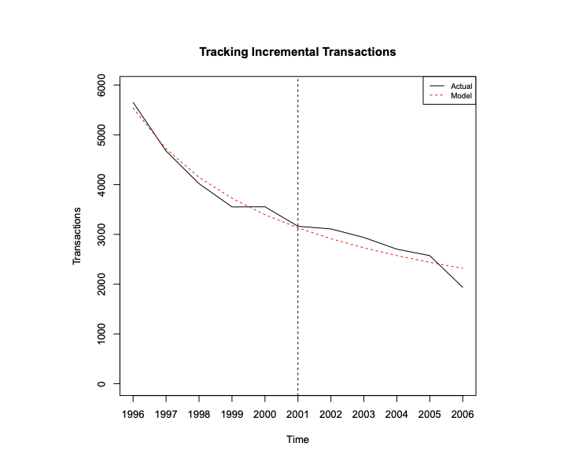
Goodness of Fit

Slide 18
Road to Customer Centricity
NOT ALL CUSTOMERS ARE CREATED EQUAL!

Slide 19
Resources
Researchers: Peter Fader, Daniel McCarthy, Bruce Hardy, Christopher Heitz
Books: Customer Centricity, Customer Centricity Playbook
Podcast: The Customer Equity Accelerator Podcast by Allison Hartsoe
Blogs: First Retail, Theta Equity Partners, Ambition Data
Contact me directly: felix.schildorfer@firstretail.com

